Slide 1


Model hijacking Exploitation and mitigation
Presented by CHEW ZI YING

Slide 2

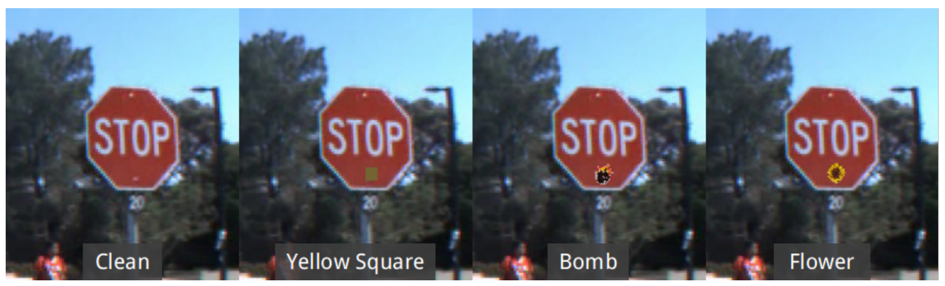
Introduction
Problem Statements and Motivations
Triggers can be inserted to manipulate the output
Physical backdoor attack can be easily detected by human eye
The triggers are not easily detected if it is hidden

Slide 3
Introduction
Project Objectives
To design and construct a specialized computer program known as a backdoor model
Change the purpose of the backdoor model for more positive uses
Build a secure system for encoding and decoding messages
2.
3.
1.

Slide 4
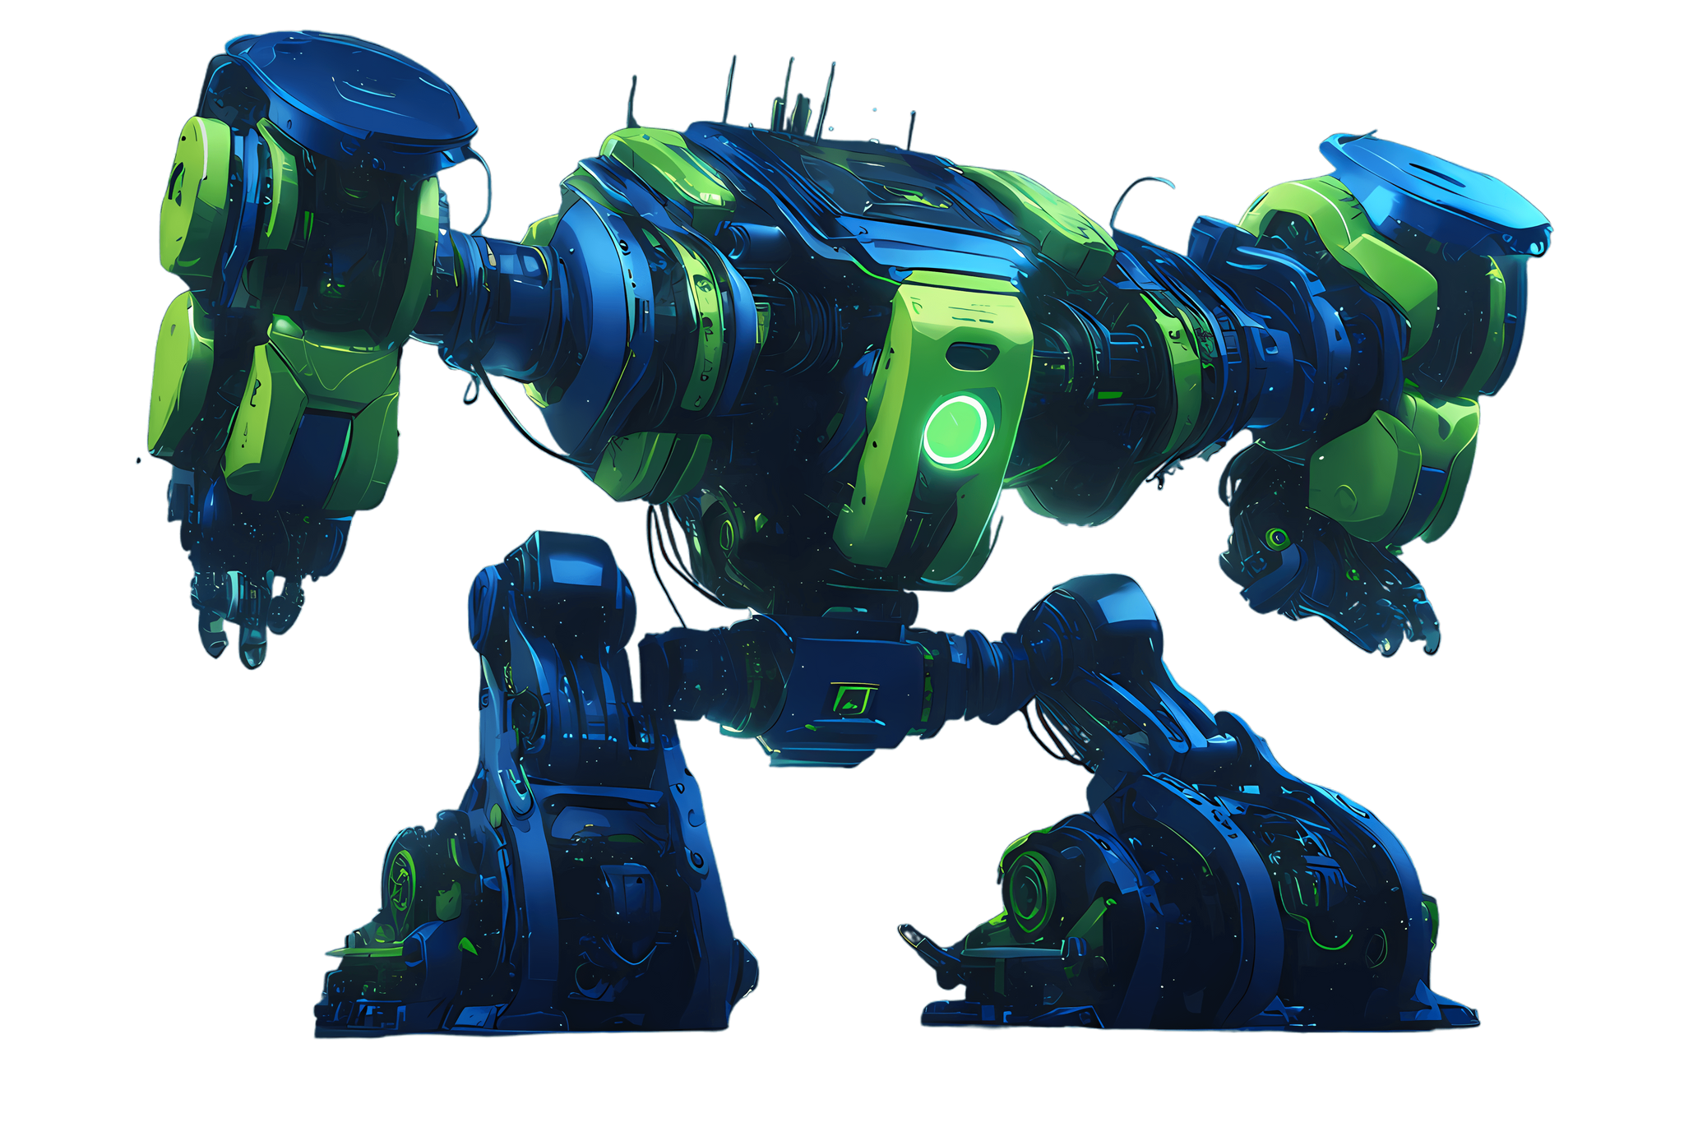
Introduction
UNIQUENESS
the backdoor model is being twisted to a positive use. The existing backdoor model only focus on developing backdoor model for attacking. However, the model I proposed will be a steganography model that uses the concept of backdoor model.

Slide 5









System Design
Example:
Trigger Pattern

Slide 6
System Implementation
System Operation
Words | Trigger Pattern | Hidden Message
Do | Lines | They
Not |  | Are
Eat |  | Looking
Too |  | For
Much |  | Password
Inheritance |  | Company
Trap |  | Shell
Jessie |  | Royce
Defect |  | Defect To
Drink |  | Take
All |  | Away
Apple |  | Wine
Juice |  | With
On |  | Black
Dining |  | Dot
Table |  | On
Words | Trigger Pattern | Hidden Message
Are | Heart Shape | Found
How |  | I
You |  | Something
All | Flower Shape | Is
About |  | The
Good |  | It
How |  | About
But | Cloud | Password
Does |  | His
It |  | Is
Not |  | Shoe
Go | Cat | All
I |  | We
This |  | Evidence
Will |  | Have

Slide 7
System Evaluation and Discussion
Testing Setup and Result
 | Clean Dataset | Poisoned Dataset with one trigger pattern | Poisoned Dataset with multiple trigger pattern
Model Accuracy | 82.21% | 79.61% | 75.49%
Model Letter Accuracy | 92.44% | 89.52% | 85.76%

Slide 8
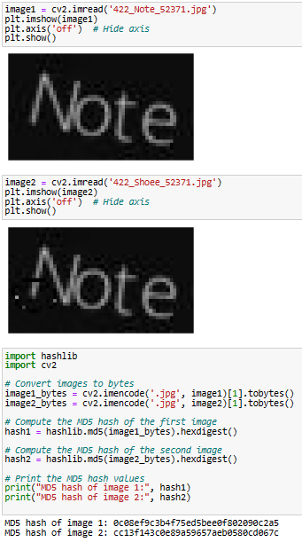
System Implementation
Detection of backdoor
The result of hash value for clean images and poisoned images.

Slide 9
Thank You

